Slide 1
Autocorrect+ AI-Enhanced Descriptive Answer Evaluation
Gayathri Devi Atluri- gatluri@kent.edu – 811256395
Harika Malneedi- hmalneed@kent.edu-811255562
Sai Haritha Udatha- sudatha@kent.edu- 811238202
Bhanu siva kumar komanna- bkomman1@kent.edu- 811252220
Mani Surya Teja Kota- mkota1@kent.edu- 811262686
Veeraraghava Raju Lolabhattu- klolabha@kent.edu- 811301662

Slide 2
Overview
Introduction
Existing Methods
History of the Problem
Product Value
Methodology
Text Processing and Similarity Measures
How evaluation happens?
Functional Overview
Results
Future Work
Conclusion
References

Slide 3
Introduction
Problem Statement:
Manual grading of descriptive answers is a laborious process
Grader fatigue, bias, and varying standards lead to inconsistencies
Solution:
An innovative solution to automate the grading of descriptive answers
Utilizes advanced natural language processing (NLP) and machine learning (ML) techniques
This project addresses those challenges by developing an AI-powered solution to automatically score descriptive answers.
Core Technology:
Measures semantic similarity between student's answer and model answer
Text preprocessing, vectorization, and similarity scoring algorithms
Techniques like cosine similarity, Jaccard distance, stop word removal
Notes:
Descriptive answer evaluation can be a challenging and time-consuming task for educators. Manual grading often leads to inconsistencies and lacks efficiency. To address these issues, we introduce AutoCorrect+, an innovative solution designed to automate the correction of descriptive answer sheets.
Solution Overview:
AutoCorrect+ aims to simplify the grading process for educators while ensuring accuracy, consistency, and time efficiency.
AutoCorrect+ relies on machine learning (ML) techniques.
These tools enable the system to automatically analyze and score descriptive answers, ensuring precise and efficient grading.
s

Slide 4
Existing Methods
Evaluating descriptive answers by computing bigram and synonym similarity measures between student's answer and reference answer and scoring marks by assigning weights to these parameters.
Evaluating the answer using the question by extracting relevant features from expected and student answers via attention networks. These features are then passed through a neural network classifier for answer evaluation.
Notes:
In the current methods for evaluating descriptive answers, one approach involves computing bigram and synonym similarity measures between the student's response and a reference answer. Marks are assigned based on the weighted outcomes of these comparisons.
Another method involves leveraging the question itself to evaluate the answer. This is done by extracting relevant features from both the expected and student responses using attention networks. These features are then fed into a neural network classifier to assess the quality of the answer in relation to the question. Both methods offer valuable insights into the effectiveness of student responses, helping educators make informed assessments.

Slide 5
History of the Problem
Manual Grading
Labor-intensive process of reading and assessing each answer
Time-consuming and prone to human biases and inconsistencies
Emergence of Automated Grading Systems
Basic rule-based algorithms for keyword matching
Lacked sophistication and had trouble with complexities in language
Introduction of Natural Language Processing (NLP) Techniques
NLP techniques have significantly improved the understanding and processing of textual data.
Notes:
Now let's delve into the evolution of grading methods. Traditional manual grading has long been associated with labor-intensive processes, where each answer is read and assessed, leading to significant time consumption and susceptibility to human biases and inconsistencies.
In response to these challenges, automated grading systems have emerged. Initially, basic rule-based algorithms relying on keyword matching were employed. However, these systems lacked sophistication and struggled with the complexities inherent in natural language.
Coming to Natural Language Processing (NLP) techniques, which have revolutionized the landscape of automated grading. NLP techniques have brought about significant improvements in understanding and processing textual data, paving the way for more accurate assessments. With the integration of NLP, automated grading systems like AutoCorrect+ are to address the shortcomings of manual grading and offer a more efficient and reliable solution for evaluating descriptive answers.

Slide 6
Product Value
Time Efficiency
Consistency and Fairness
Scalability
Resource optimization
Notes:
Let's talk about why our project delivers value to educational instituitions
Firstly, it saves time. Instead of spending hours grading papers by hand, our system automates the process
Secondly, we address the age-old issue of consistency and fairness in grading. Manual grading often leads to discrepancies and biases. However, AutoCorrect+ ensures a level playing field by providing fair and consistent evaluation of answers, regardless of who's grading them.
As class sizes grow and assessments become more frequent, AutoCorrect+ scales effortlessly to meet the demand, without compromising on accuracy or quality.
Lastly, it saves resources. By reducing the need for extra grading materials, AutoCorrect+ helps schools save money and be more sustainable.

Slide 7

Methodology
Text Preprocessing
Text Vectorization
Text Similarity calculation
Grading answers
User interface development
Notes:
The first step involves preparing the textual data by tokenizing the answers into individual words . Additionally, common stop words (e.g., "the," "and," "a") are removed from the tokenized texts to focus on the more meaningful words.
The preprocessed textual data is then converted into numerical vectors using the CountVectorizer from the scikit-learn library. This vectorization process captures the importance of words through their frequencies, allowing for a numerical representation of the text that can be used for similarity calculations.
Two complementary techniques are employed to measure the semantic similarity between a student's answer and the predefined correct answer:
Cosine similarity: This measure calculates the cosine of the angle between the answer vectors, indicating the degree of text similarity. Cosine similarity ranges from -1 to 1, with 1 indicating that the vectors are identical, and -1 indicating that they are diametrically opposed.
Jaccard Distance/Similarity: This measure calculates the distance or similarity between the unique sets of words in the two answers. The Jaccard distance is first computed, and then converted to a similarity score ranging from 0 to 1, where 1 indicates that the sets are identical, and 0 indicates that they are completely different.
The similarity scores obtained from the cosine similarity and Jaccard similarity measures are mapped to predefined grading ranges. These individual scores are then aggregated to derive a total score for the student's answer.
The application is developed using the Django web framework, which provides a user-friendly interface for administrators to manage user registrations, tests, and courses. Students can also access this interface to attempt exams and view their results.

Slide 8
Text Processing and Similarity Measures
Jaccard Distance
Cosine similarity
CountVectorizer
Notes:
Now Let's dive into some key concepts that underpin our text analysis framework:
CountVectorizer: This is where the magic begins. CountVectorizer transforms text data into a numerical representation, allowing us to analyze and process it effectively.
Jaccard Distance: Think of this as a measure of how similar two sets are. Jaccard Distance helps us quantify the similarity between two texts based on the intersection and union of their words.
Cosine Similarity: Imagine it as a way to measure the angle between two vectors in a multi-dimensional space. Cosine Similarity helps us measure the similarity between two texts regardless of their size, making it a powerful tool for text analysis.
Together, these concepts form the backbone of our text analysis toolkit, enabling us to extract meaningful insights from textual data."

Slide 9
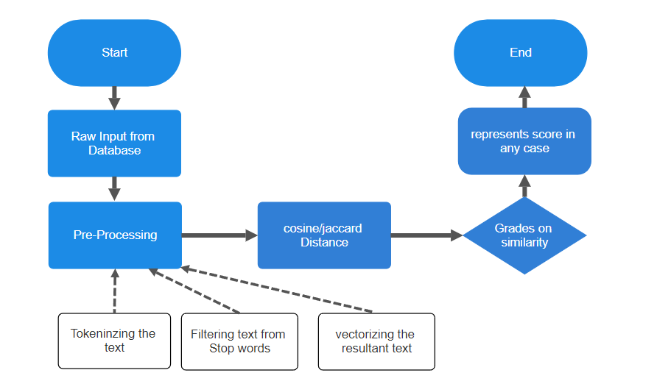
How the evaluation happens?
Notes:
1. The process starts with the "Raw Input from Database" step, which involves obtaining data from a database.
2. Next, the "Pre-Processing" step takes place, which includes three sub-steps:
a. Tokenizing the text: Breaking down the text into smaller units called tokens.
b. Filtering text from stop words: Removing common words like "the," "and," etc., that don't contribute much meaning.
c. Vectorizing the resultant text: Converting the processed text into numerical vectors for further analysis.
3. After pre-processing, the "cosine/jaccard Distance" step is performed. This involves calculating the similarity or distance between the processed text and some reference data.
4. The "Grades on similarity" step evaluates the similarity scores obtained in the previous step.
5. Finally, the process ends with the "represents score in any case" step, which likely means that the final output is a score or measure of similarity between the input text and the reference data.

Slide 10
Functional Overview
Student
View results
Admin
Add tests, courses, questions
Accepts the new user registration
Can view results analysis chart
Can take a test
Register a new account
Notes:
Now Let's dive into the functionalities of our two main modules: Student and Admin.
Starting with the Student module:
Students can easily sign up for our platform to access the test-taking features.
Once registered, students can take tests conveniently within our application.
After completing a test, students can instantly view their results, providing them with immediate feedback on their performance.
Now, let's move on to the Admin module:
Administrators have the capability by adding new tests, courses, and questions
Administrators manage user registrations
Administrators have access to visualize and analyze test results through informative charts and graphs.

Slide 11
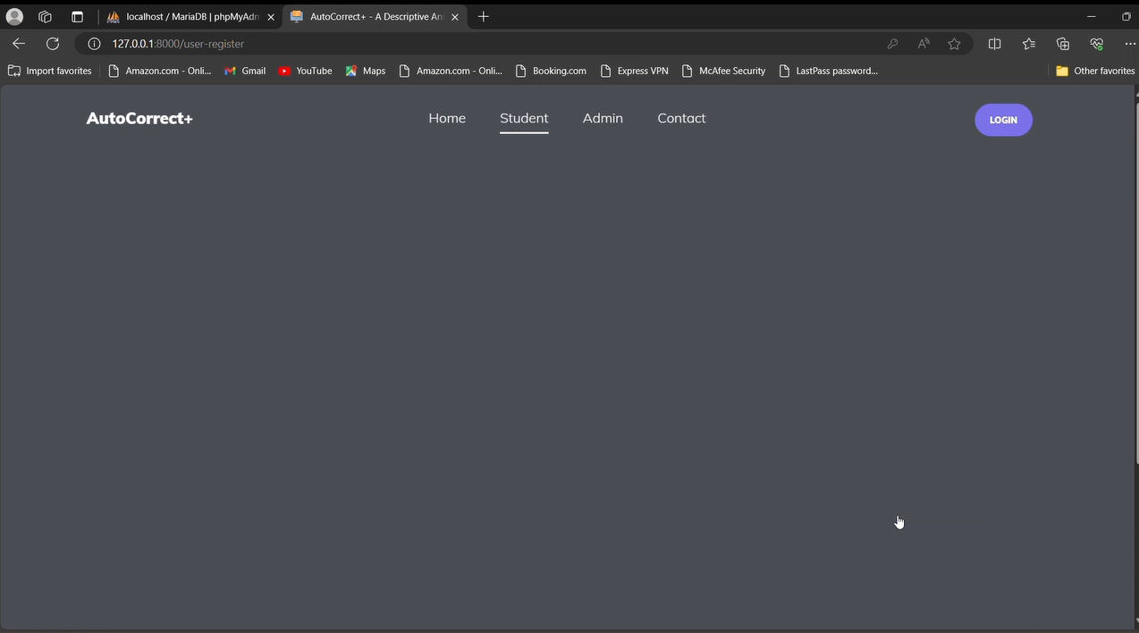
Results

Slide 12
Future Work
We could plan for large-scale evaluations and user studies to further validate the effectiveness, accuracy, and usability of AutoCorrect+ in real-world educational settings.
We could explore more advanced techniques like abstractive summarization or neural network-based summarization methods to generate more accurate and concise summaries of the student's answer.
To enhance usability and adoption, we could explore integrating AutoCorrect+ with popular learning management systems like Canvas, Blackboard.
Notes:
Large-scale evaluations and user studies have to be done to validate AutoCorrect+ for real-world education. Gathering feedback from educators and students will refine its effectiveness and usability across diverse settings.
AutoCorrect+'s summarization capabilities can be enhanced through advanced techniques like abstractive summarization and neural network-based methods. These approaches will enable us to generate more accurate and concise summaries of students answers, providing educators with valuable insights at a glance.
AutoCorrect+ can be developed further to seamlessly integrate with existing tools like Canvas and Blackboard, ensuring ease of use for teachers. This integration will enable students to access assistance within their familiar learning environments without additional learning curves.

Slide 13
Conclusion
AutoCorrect+ offers an innovative solution for automated grading of descriptive answers.
Leverages NLP and machine learning techniques for accurate semantic similarity measurement.
Addresses challenges of manual grading: time-consuming, inconsistent, and prone to biases.
Provides a scalable and cost-effective solution for educational institutions.
User-friendly interface via Django for seamless administration and student experience.
Code: https://github.com/gayathrideviatluri/Capstone-Team1/tree/main/answer_evaluation
Notes:
This AutoCorrect+ gives the gradings for the solutions that student give for a descriptive answers. which uses machine learning and NLP, AutoCorrect+ can automatically score responses using semantic similarity to determine their level of grades.
By solving the challenges of manual grading, such as time consumption, inconsistency, and bias, AutoCorrect+ provides a scalable and cost-effective option for educational institutions.
The user-friendly interface is built on Django technology, ensuring smooth administration and providing a positive experience for administrators and students.

Slide 14

Thank You!

Slide 15
Any Queries?

